Slide 1

Robotic Positioner
Add things here if needed
PRESENTED BY GROUP 5: Thomas Hu, Jordan Smith, Jason Wong

Slide 2
01
Overview
Doepker Industries Ltd
Problem Description
Requirements Analysis
System Alternatives
System Design
Q&A
TOPIC HIGHLIGHTS

Slide 3
DOEPKER INDUSTRIES LTD
02

Slide 4
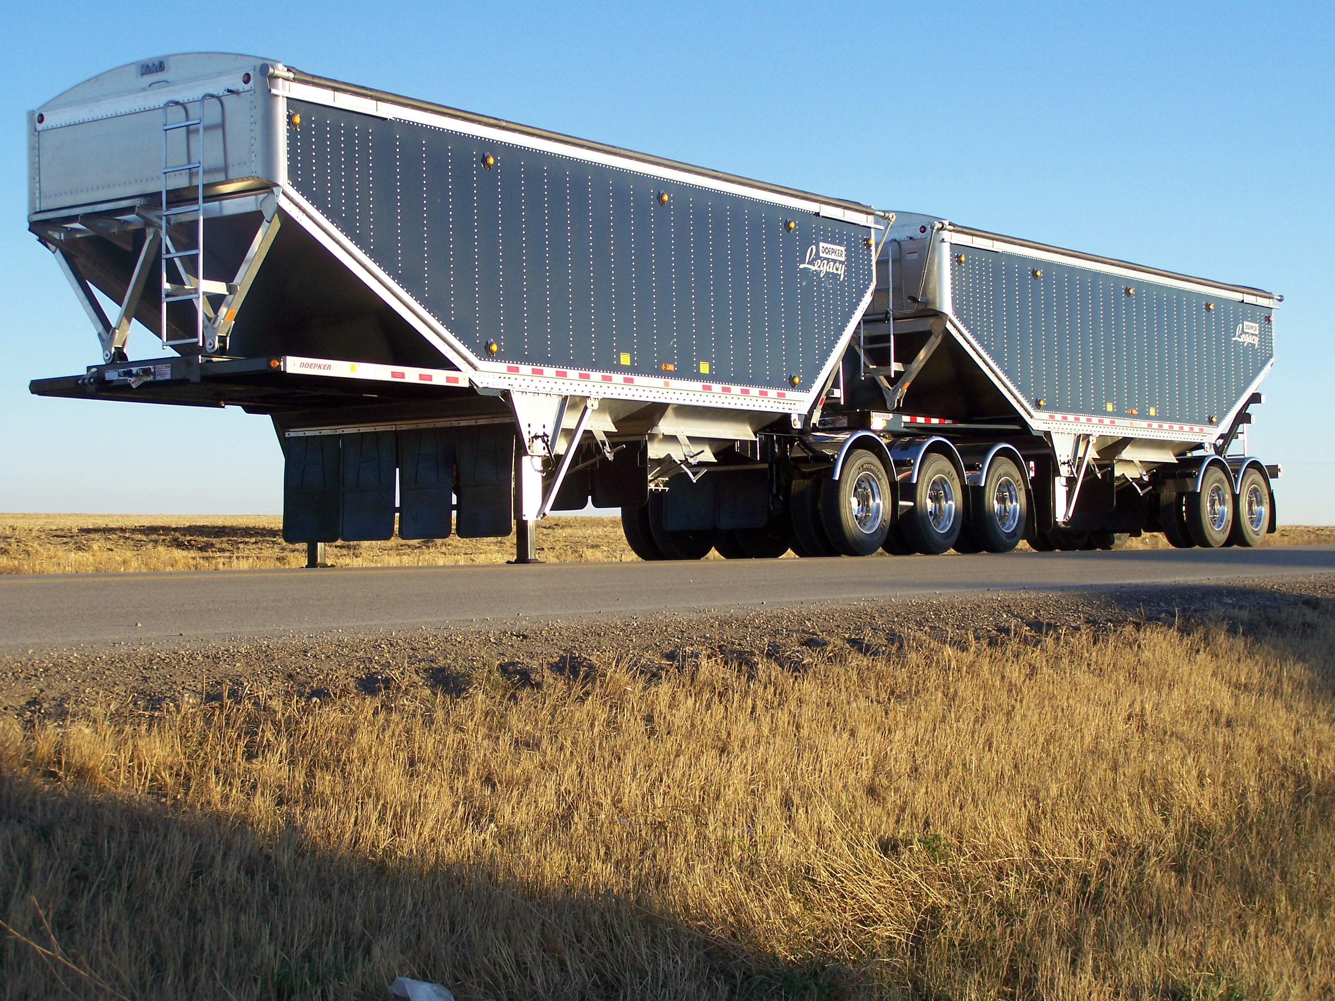
What is Doepker Industries?
stuff
03

Slide 5
PROBLEM DESCRIPTION
02

Slide 6
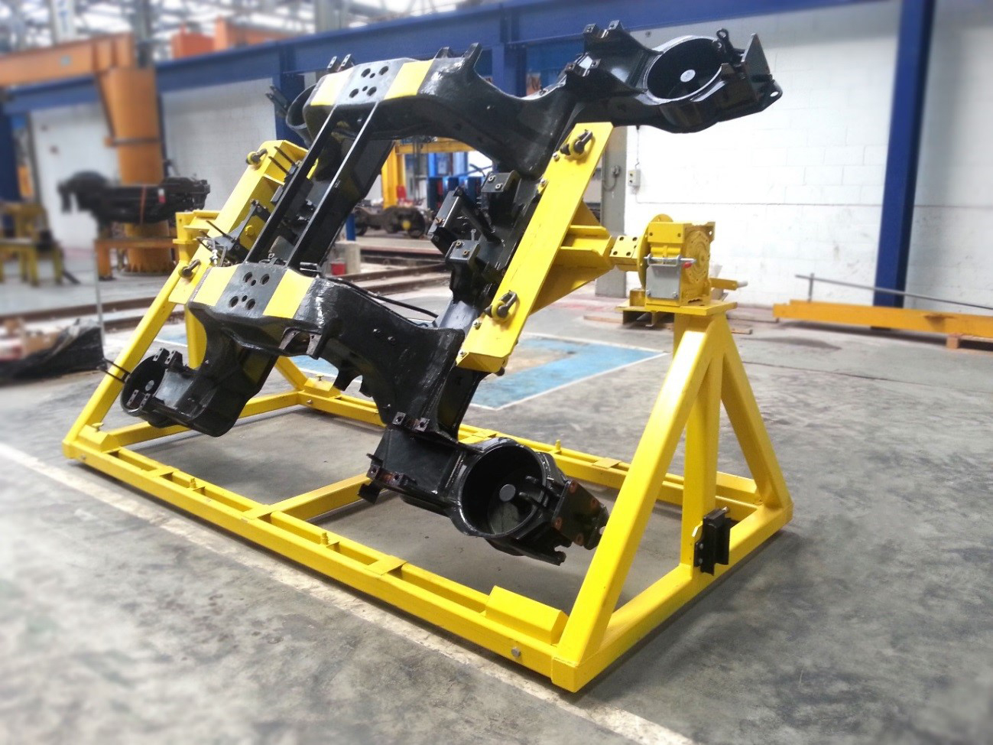
Problem Definition
A device which can be used to rotate equipment for welding, blasting, painting, or finishing that can be mounted to their existing rotator frames.
03

Slide 7
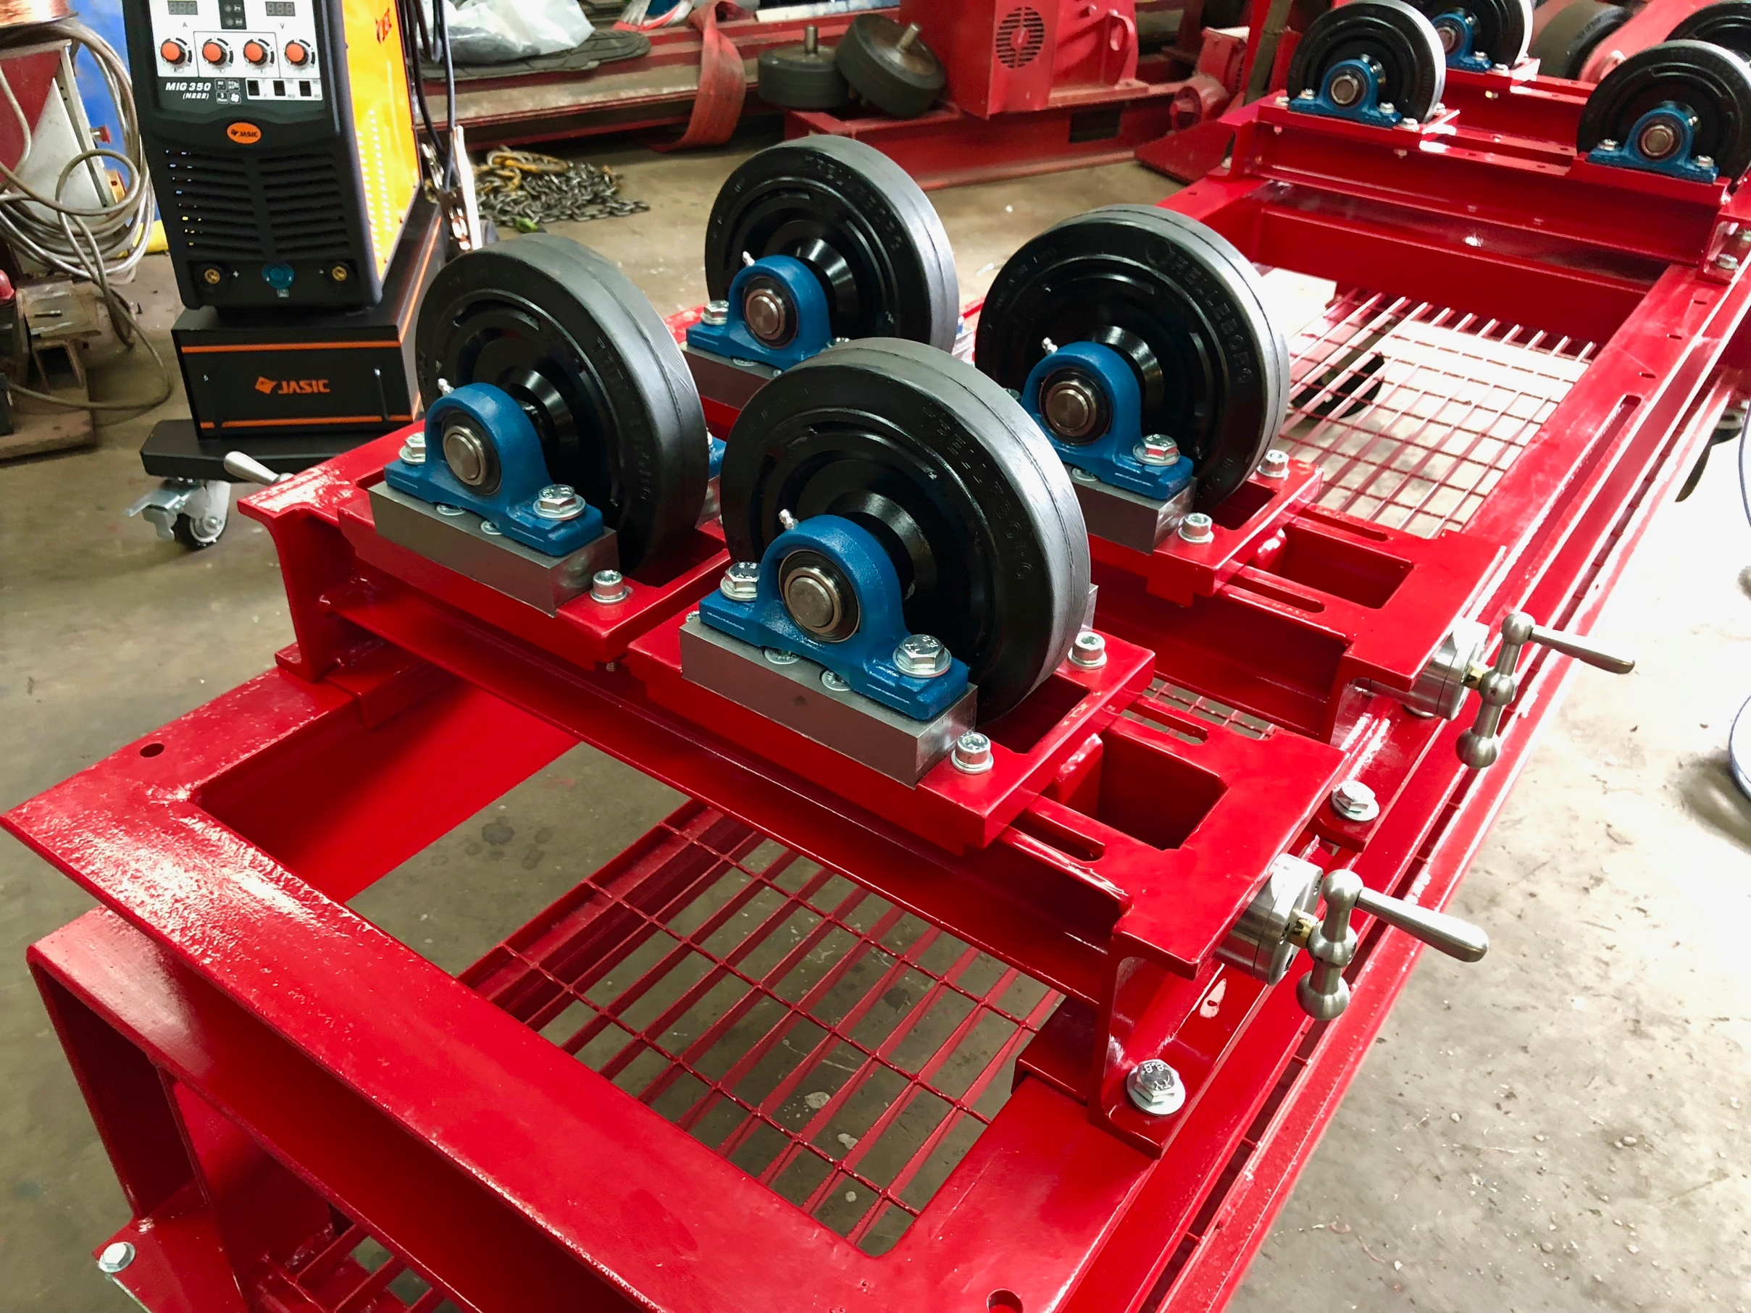
Why is this important?
04
Advancing mechanical machines forward with electronics.
Provides a safer environment for the users.
Improves efficiency.

Slide 8
Problem Statement
05
“There exists a need for a low cost system that can electrically rotate a load for welding applications to increase efficiency and safety.”

Slide 9
REQUIREMENTS ANALYSIS
06

Slide 10
Design Requirements
07
The system must rotate a load 360 around a horizontal axis
Be able to recall and rotate to 4 different angle positions (physical buttons & E-stop)
Must be able to support up to max load of 500 kilograms (kg)
The speed of the rotations must be 1-5 rpm
The system shall be built using two “A” frame supports provided by the client
Total cost of the system components must not exceed $10,000 Canadian Dollars
All components used are RoHS compliant

Slide 11
Requirements Justification
08
Device enclosure requirement
Operating in an industrial environment
Must be able to support up to max load of 500 kilograms (kg)
The speed of the rotations must be 1-5 rpm

Slide 12
SYSTEM ALTERNATIVES
09

Slide 13
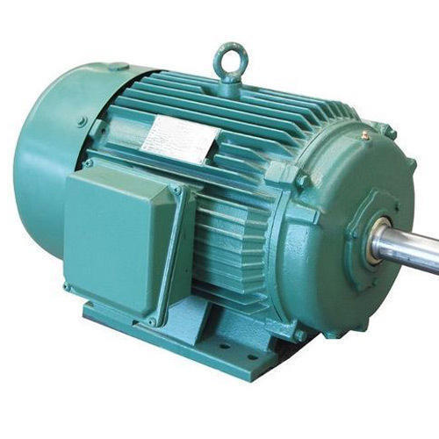
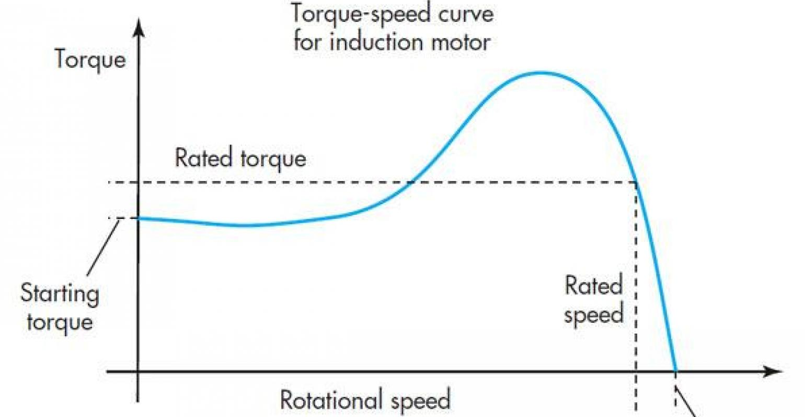
Motor Alternatives
10
Induction Motors
Pros
Inexpensive
Easy to maintain
Cons
Speed control is very limited and expensive via variable frequency drive
High in rush current when heavy loaded
Requires external positioning sensors

Slide 14
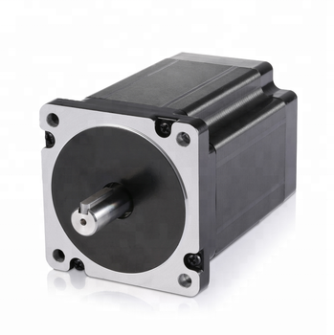
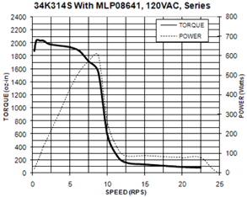
Motor Alternatives
11
Stepper Motors
Pros
High torque at lower speeds
Relatively simple operation
Possible to operate in closed loop feedback eliminating external sensor
Cons
Sudden drop off in torque as speeds increase
Noisy
Requires external driver

Slide 15
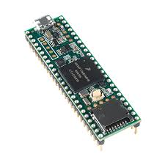
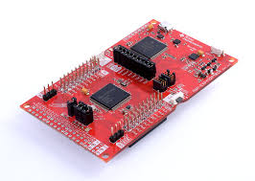
Microcontroller Alternatives
12
Teensy 3.6
TI Launchpad MSP432P401R
Pros
Powerful with lots of pins and ports
Cons
Difficult setup period
Limited library
Pros
Inexpensive
Extensive library
Expandable memory
Cons
Limited pins

Slide 16
Choosing A System
13
Employed a weighted decision matrix based on requirements and safety considerations
Requirement | Weight | Arduino Uno | Teensy 3.6 | Ti LaunchPad
Power | 5.00% | 2 | 1 | 3
Cost | 20.00% | 2 | 1 | 3
No. GPIO | 25.00% | 2 | 3 | 1
Reliability/Support | 15.00% | 3 | 2 | 1
Memory Size | 15.00% | 1 | 3 | 2
Compatibility | 20.00% | 3 | 2 | 1
TOTAL | 100.00% | 2.2 | 2.15 | 1.65

Slide 17
SYSTEM DESIGN
14

Slide 18
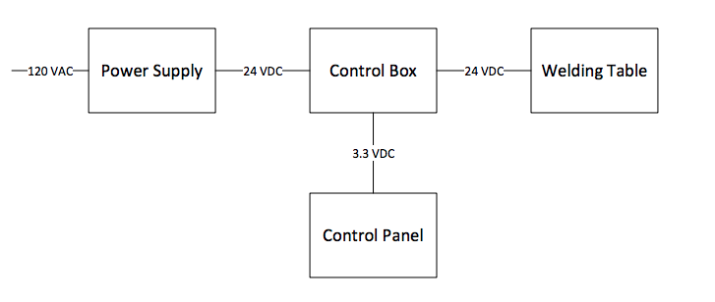
Hardware Design
15
System-Level Block Design

Slide 19
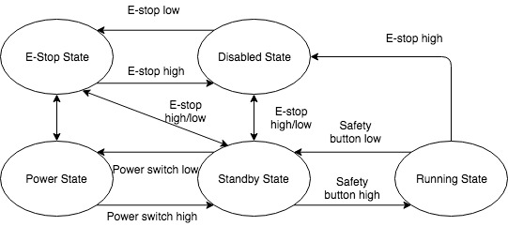
Software Design
16
System-Level Block Design

Slide 20
MICROCONTROLLER
MOTOR
A compact integrated circuit designed to operate the motor.
Rotates the gearbox to do something
ENCODER
GEARBOX
A motor mounted encoder provides closed loop feedback signals to communicate the speed and position of the motor shaft.
A mechanical drive to step down the speed of rotation from the motor shaft to the output drive, proportionally increasing the torque.
17
Key Components

Slide 21
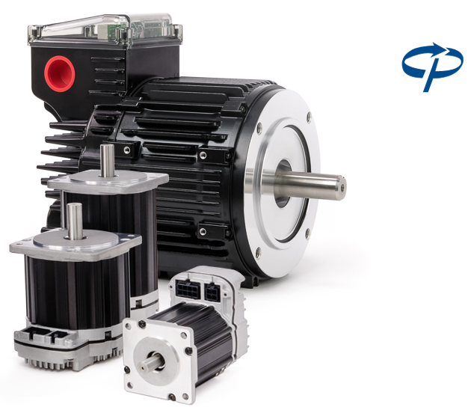
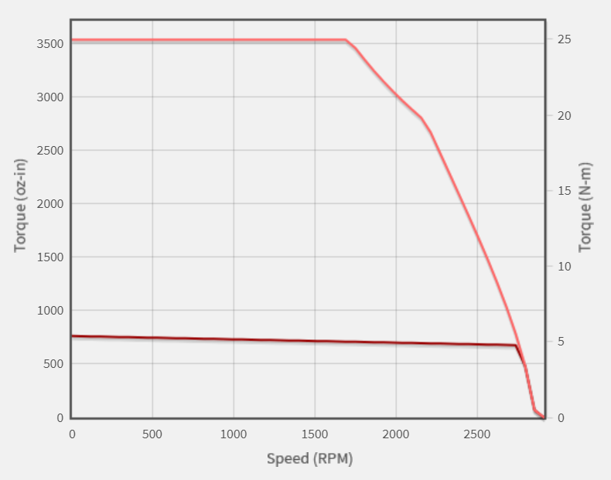
Servo Motor
Pros
Encoder allows for a closed loop feedback operation
Near constant torque within operational speeds
Integrated encoder for high precision position tracking
Cons
Expensive
18

Slide 22
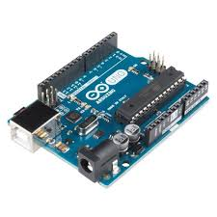
Microcontroller
Arduino Uno R3
Pros
Quickly prototype projects on to it
Store and analyze data for a motor
Easy to use
Compatibility with motor
Cons
Limited processing power
19

Slide 23
Q&A
20

